Slide 1
Agile Methods for Systems and Software Development
CIDM4390

Slide 2
SCRUM
The most successful of the Agile Methods

Slide 3
Things To Learn
Know the Roles
Know the Artifacts
Know the Events
Know the Guiding Theory
Transparency
Available for empirical measurement
Inspection
Use of empirical measurement
Adaptation
Diagnosis and Response

Slide 4
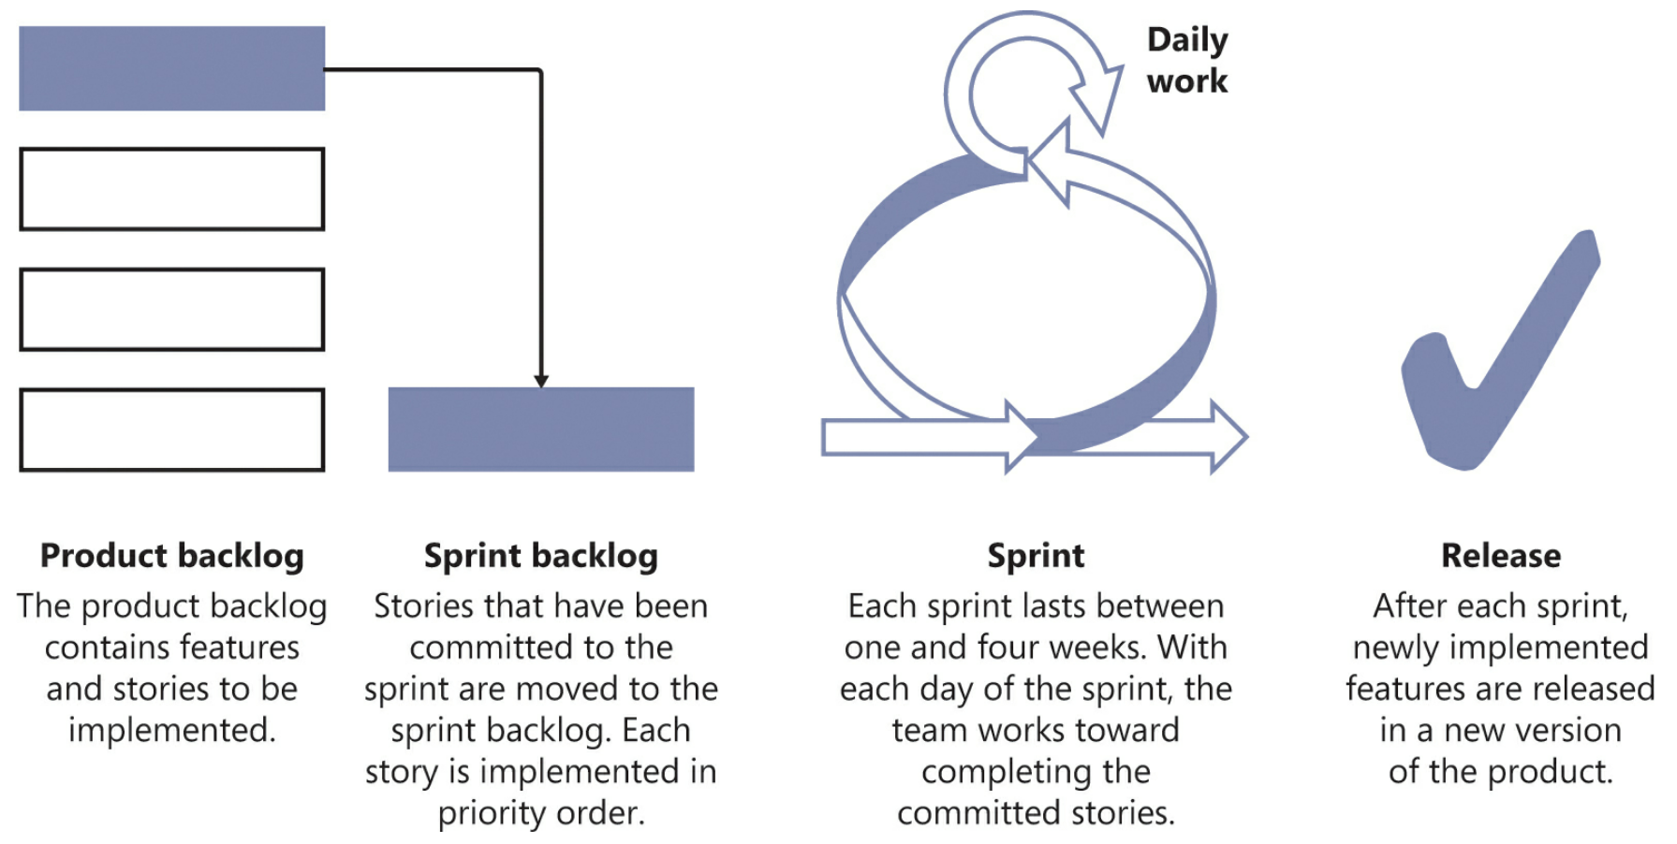
Scrummy

Slide 5
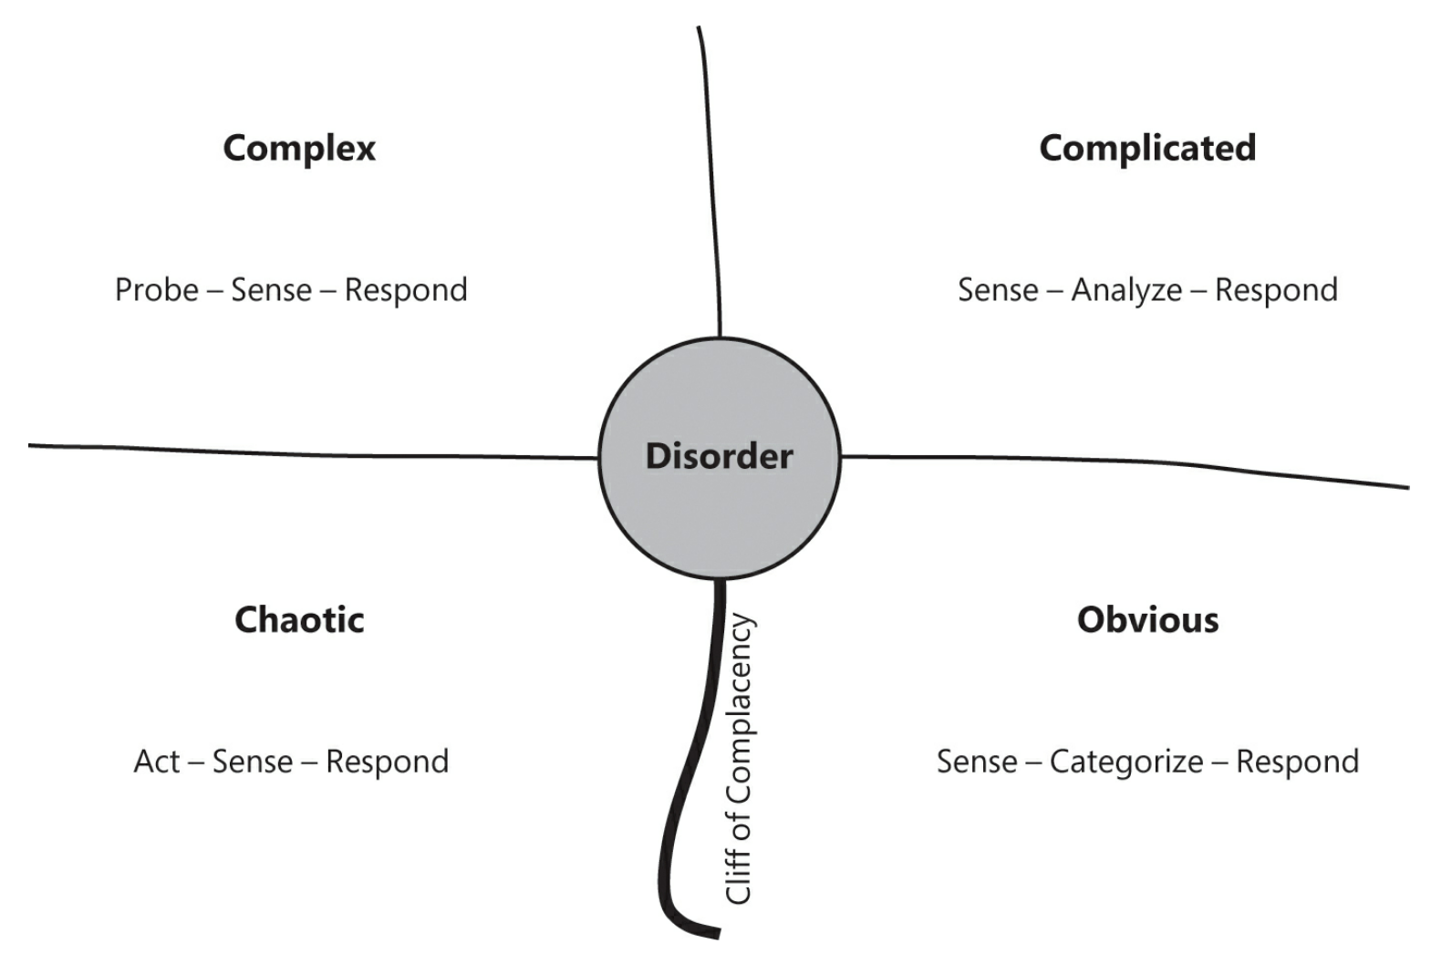
Cynefin

Slide 6
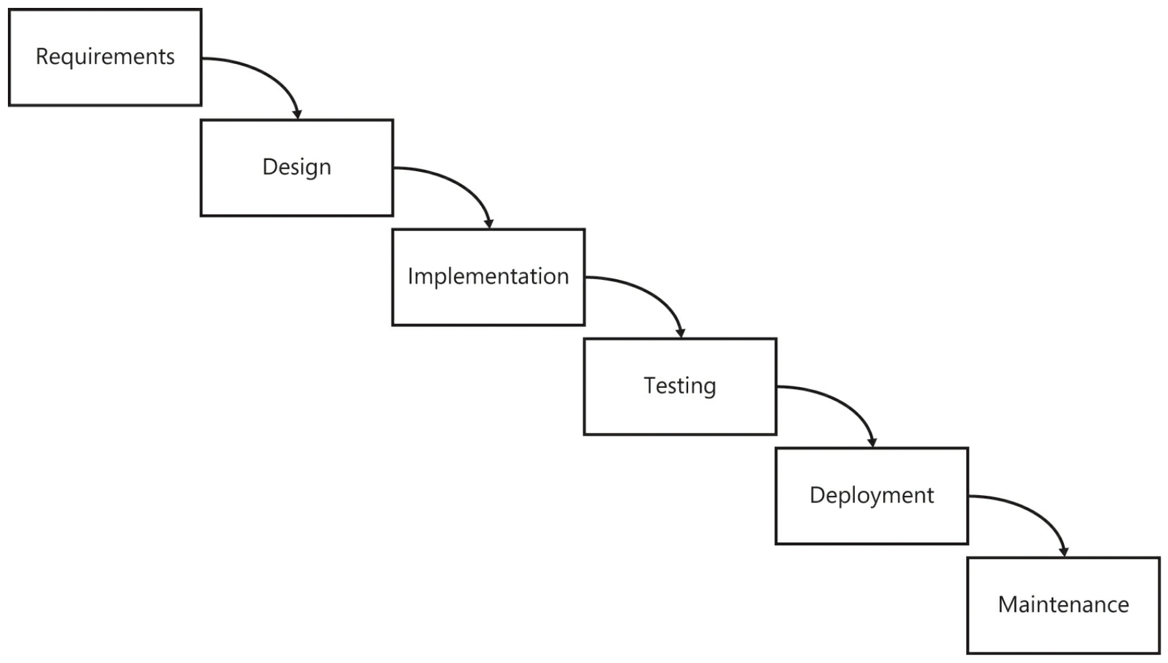
Waterfall – A Convenient Simplification

Slide 7
Scrum Orthodoxy
Straight
Fastidiously observant
But
We had to skimp/skip here and there
And
We use other methods to augment it
Kanban
Not
Abandoned for whatever reason

Slide 8
Scrum Guide
Roles
Product Owner
Scrum Master
Development Team
Pigs and Chickens
T-shaped Skills
Artifacts
Backlog
Kanban Board
Story Cards
Product
Release
Feature
Task
Done

Slide 9
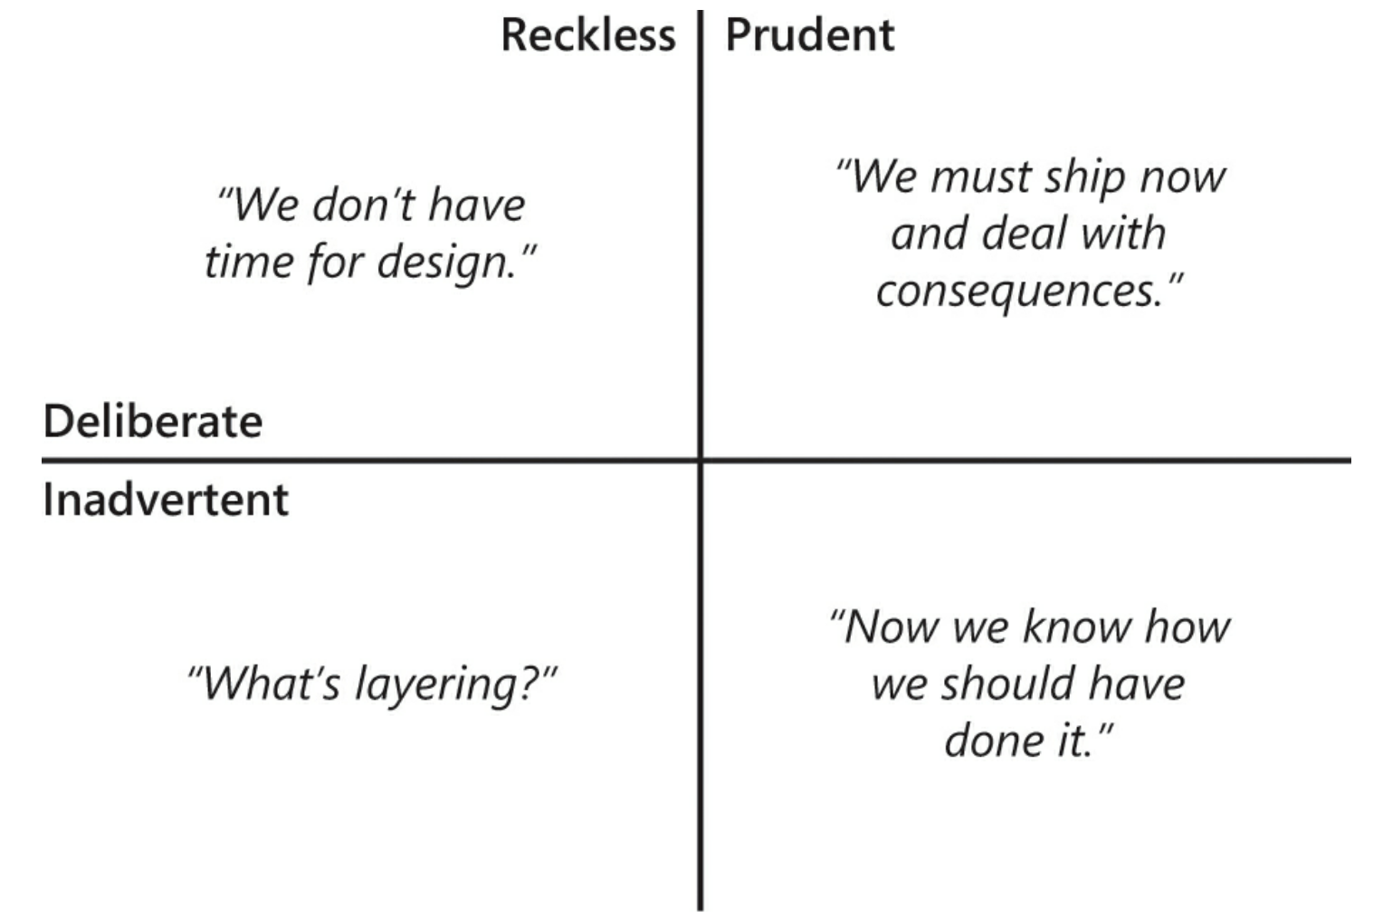
Technical Indebtedness – It will happen

Slide 10
Metric Tools
Jira, VSTS, Trello, etc.
Story Points
Planning Poker
Velocity
Backlogs
Product
Sprint

Slide 11
Information Radiators
Sprint Burndown Charts
Feature Burnup Charts

Slide 12
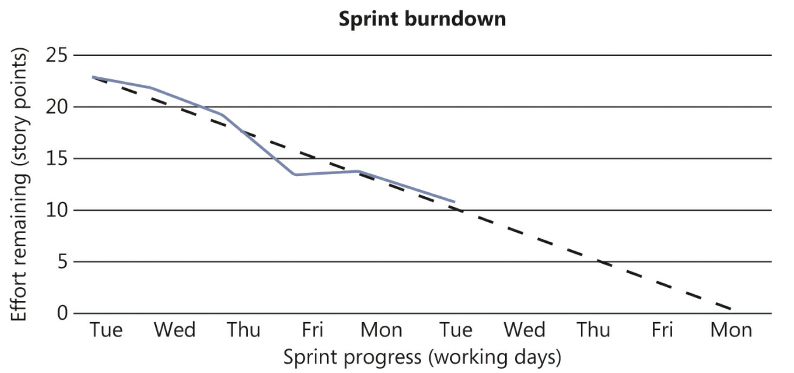
Burndown

Slide 13
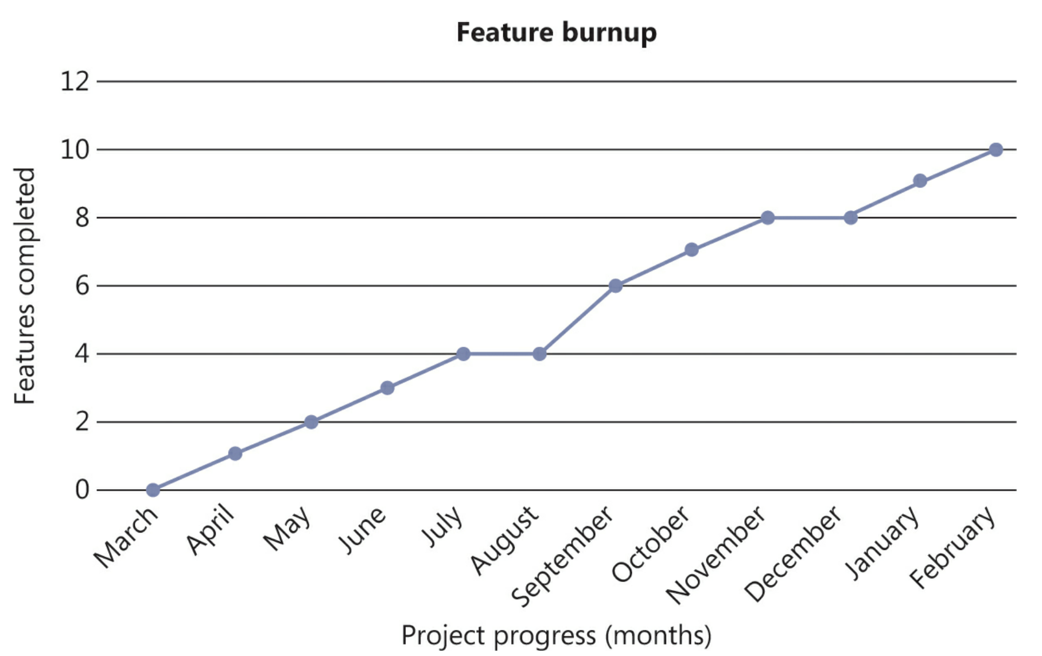
Burnup

Slide 14
The Scrum Guide
Events
Release Planning – Sprint Zero
Estimation
T-shirt sizes
Priorities
Sprints
Planning
Planning Poker
Parkinson’s Law – “Work expands so as to fill the time available for its completion”
Daily Scrum

Slide 15
The Scrum Guide
Events
Sprint Review/Demo
Sprint Retrospective

Slide 16
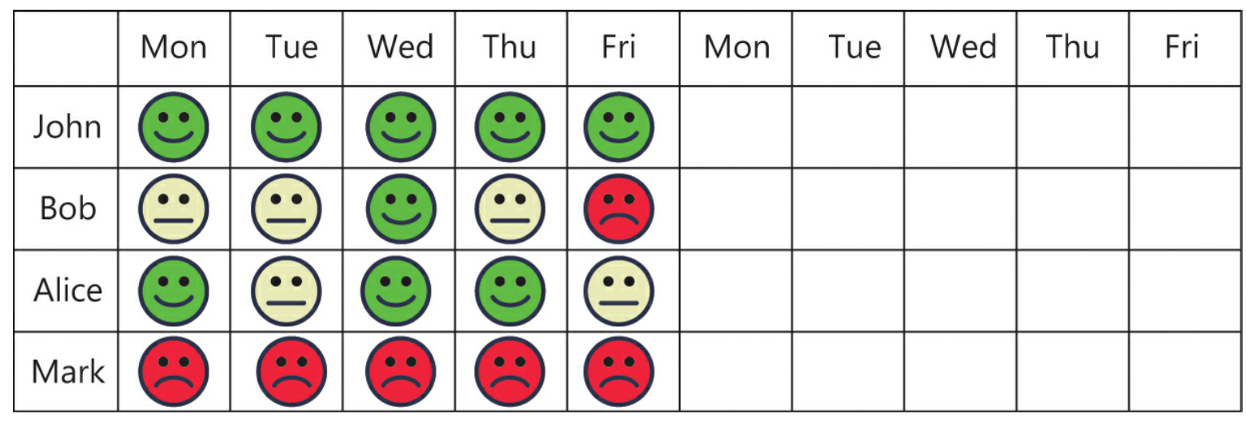
Esprit De Corps

Slide 17
Coverage
Testing
Unit
Integration
Acceptance
Regression

Slide 18
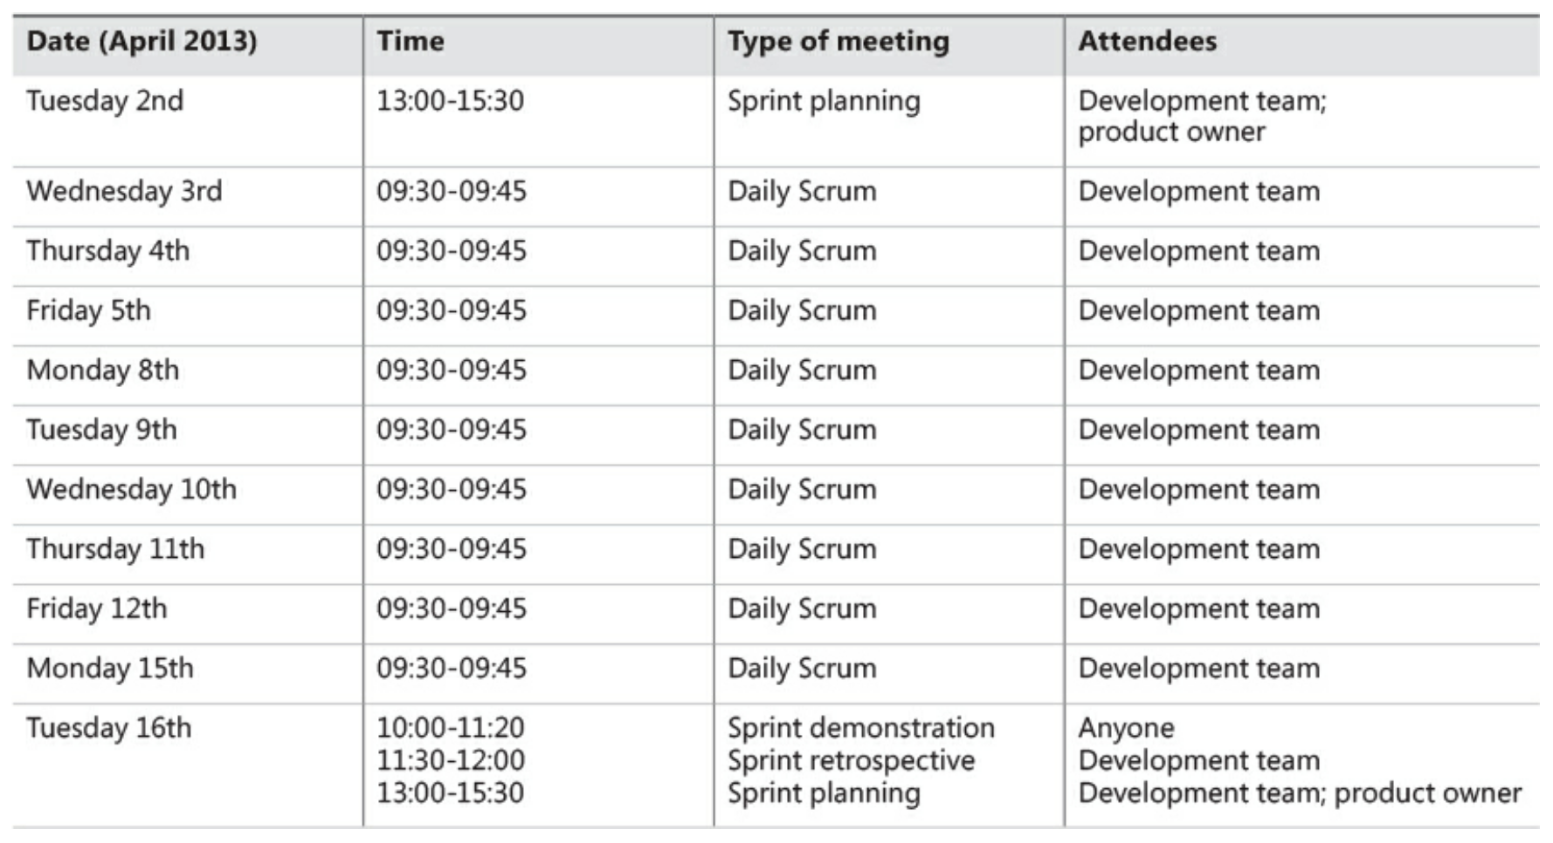
Calendaring

Slide 19
KANBAN
The “Lean” influence that often the conjunctive to Scrum

Slide 20
Things to Learn
Establish and maintain a Kanban Board
Optimize productivity as relates to the management of the board
React and Respond to what the Kanban Board tells
Analyze the efficiency and effectiveness of your workflow as revealed by the Kanban Board
What are the pros and cons of Scrum vs Kanban
How about Scrum AND Kanban?

Slide 21
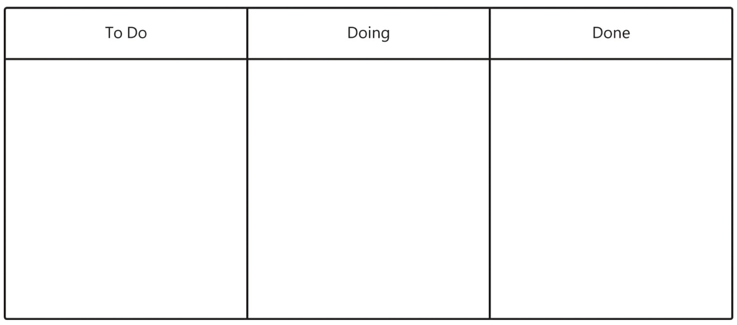
Jump Right In

Slide 22
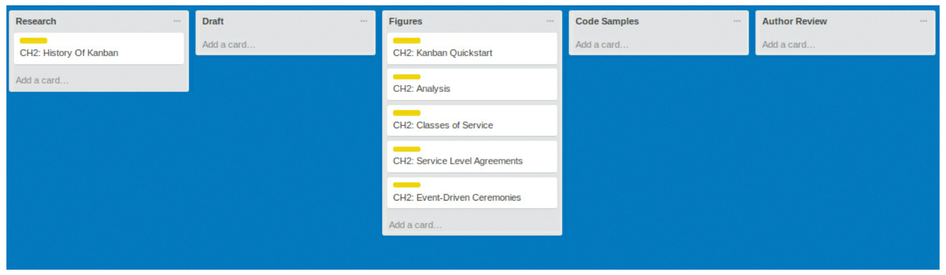
Activity: Trello for the First Project

Slide 23
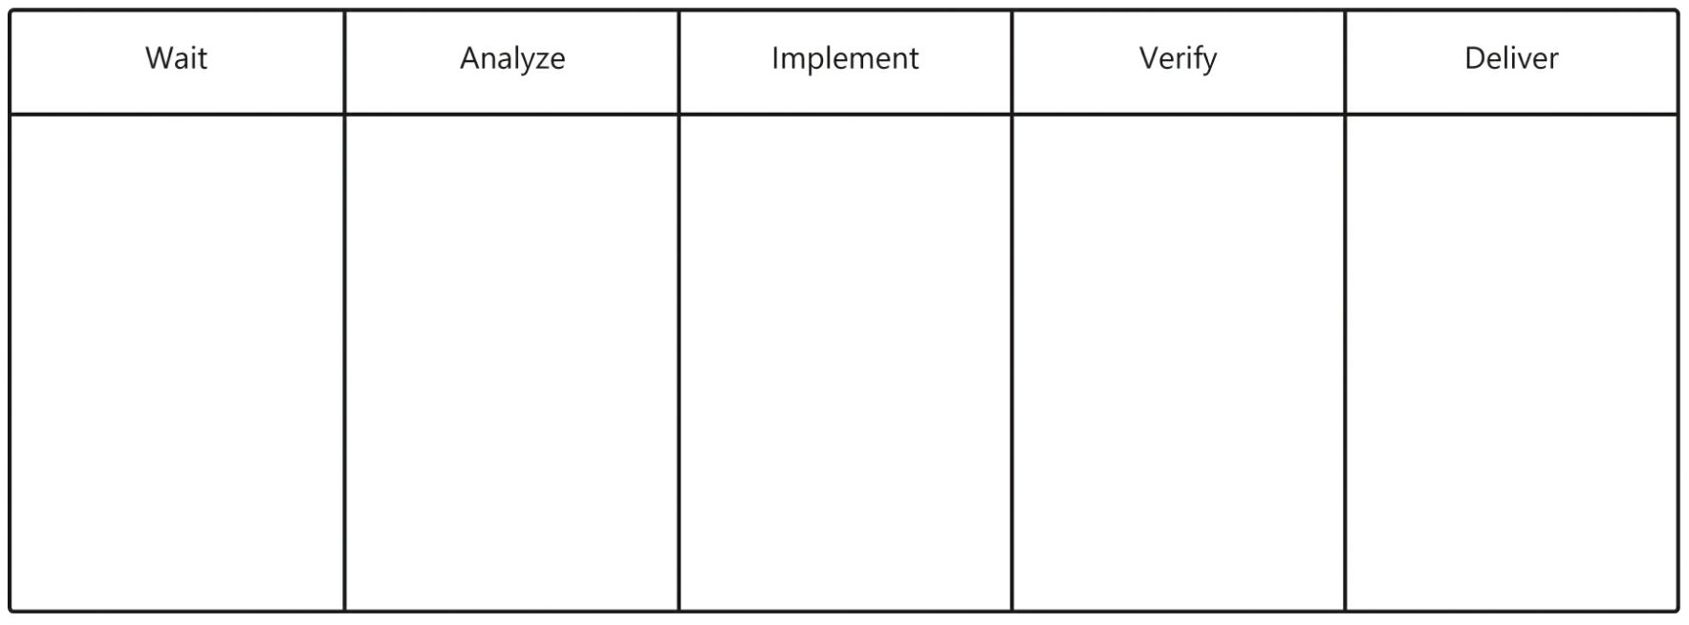
Kanban for Software Processes

Slide 24
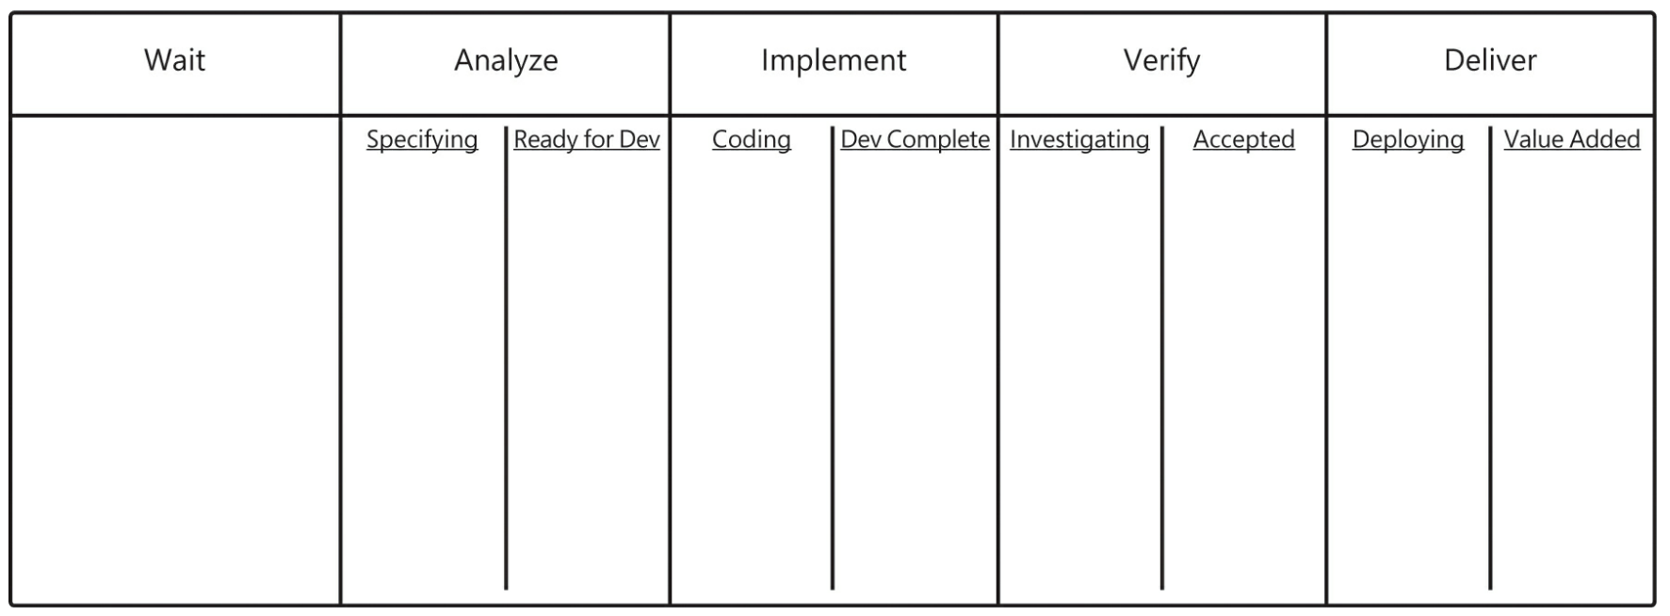
Sub states

Slide 25
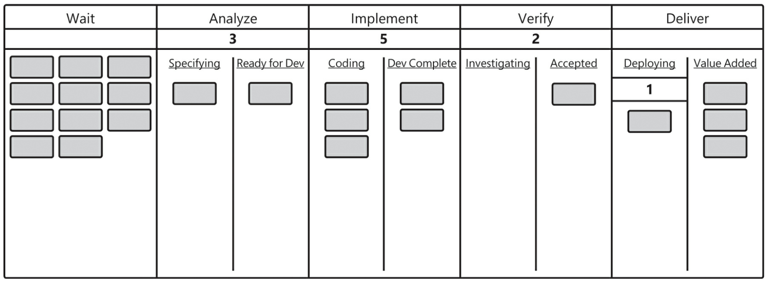
WIP Limits

Slide 26
Done
Specification – CIDM4360 and CIDM3350
Implementation – CIDM2315, CIDM3312, CIDM4390
Verification – Testing (CIDM4390)
Delivery – Deployment (CIDM4390)

Slide 27
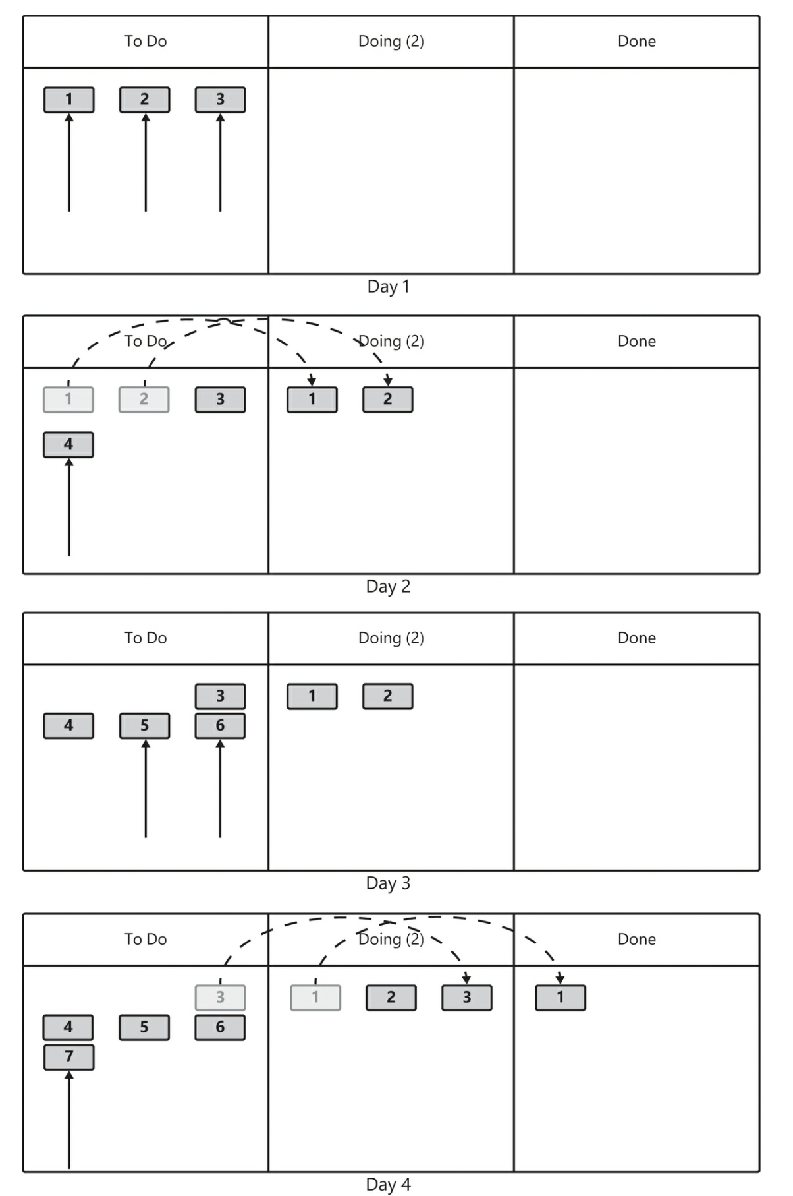
Events and Ceremonies – Board Movement
Movement triggers meetings

Slide 28
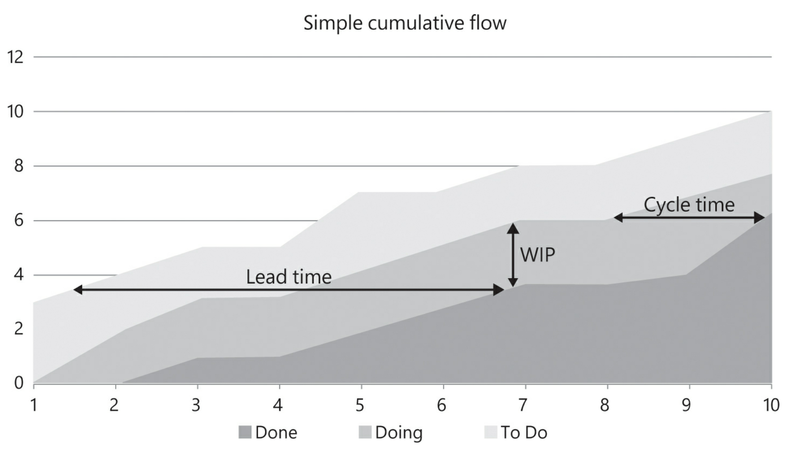
Charting

Slide 29
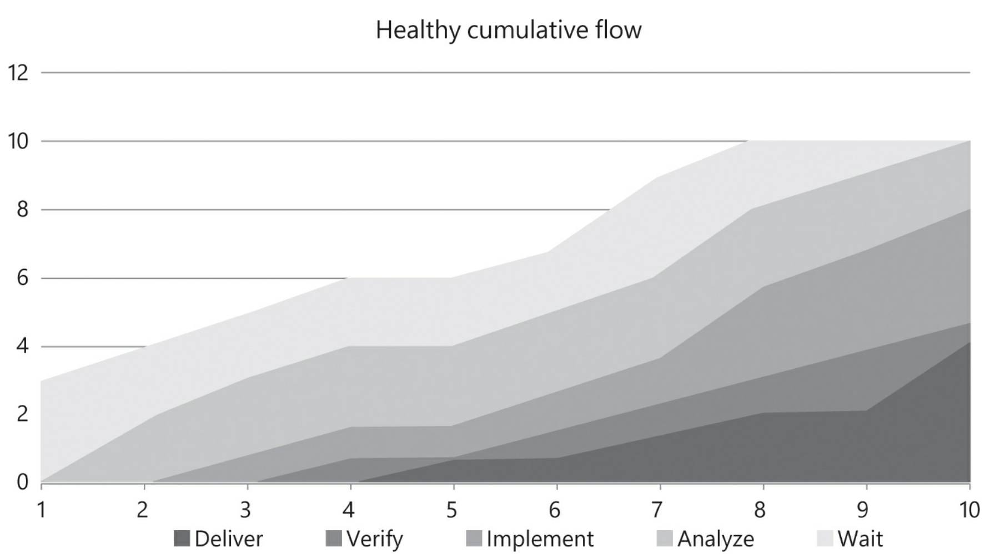
Healthy Flow

Slide 30
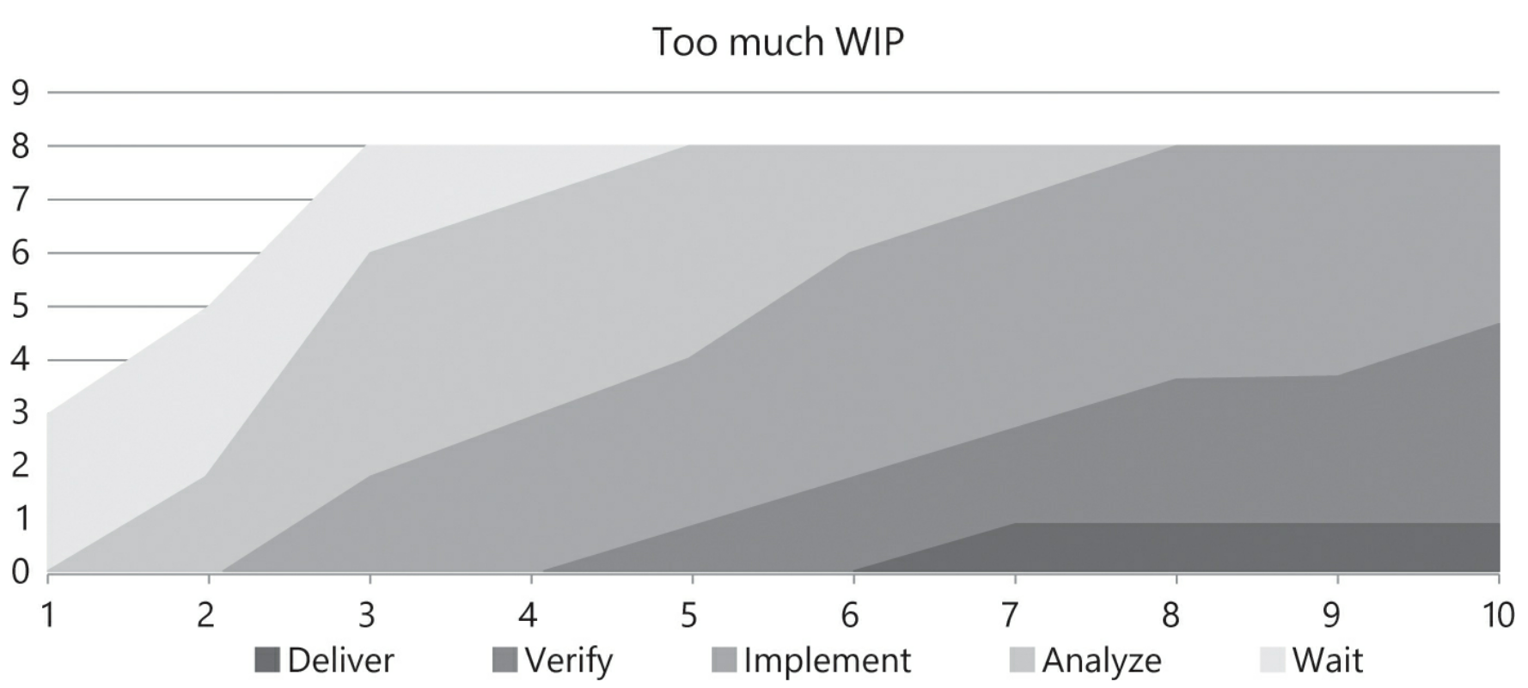
Too Much WIP

Slide 31
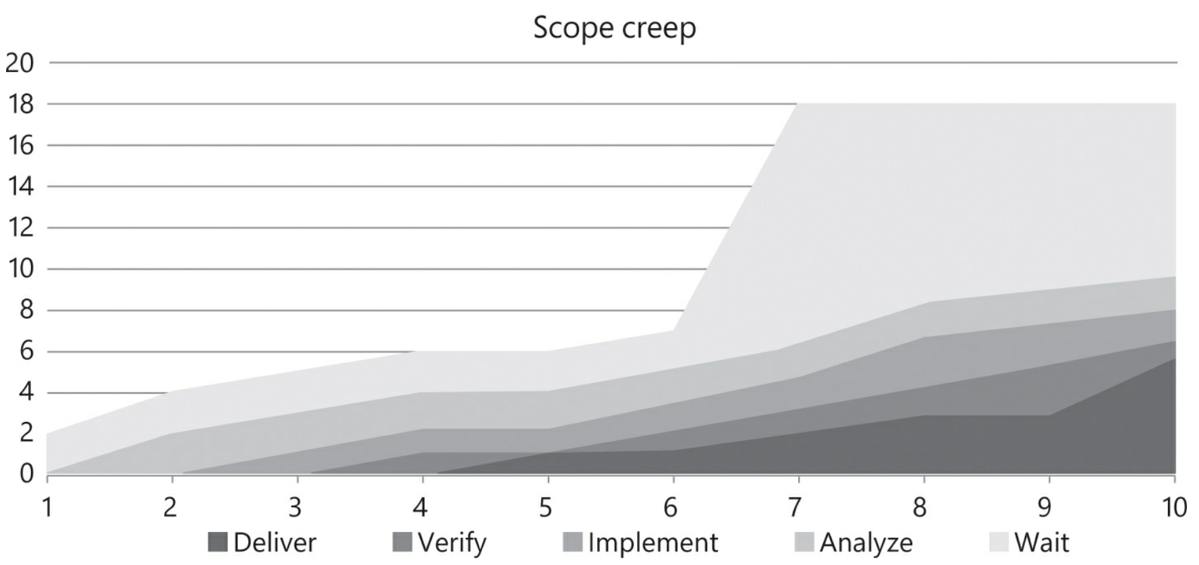
Scope Creep

Slide 32
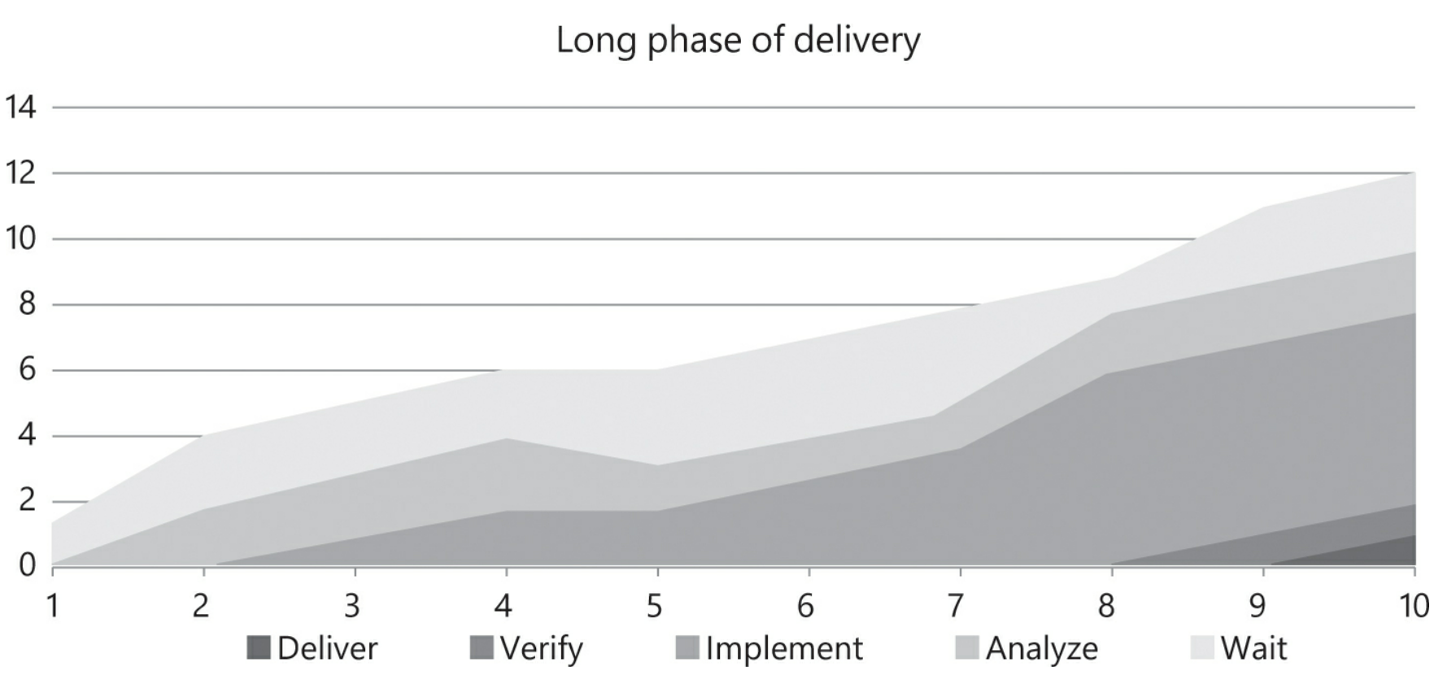
Delivery Takes Too Long

Slide 33
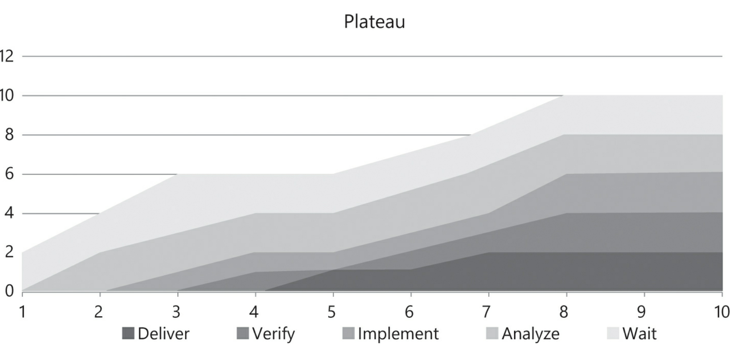
Ill Effects of Technical Debt

Slide 34
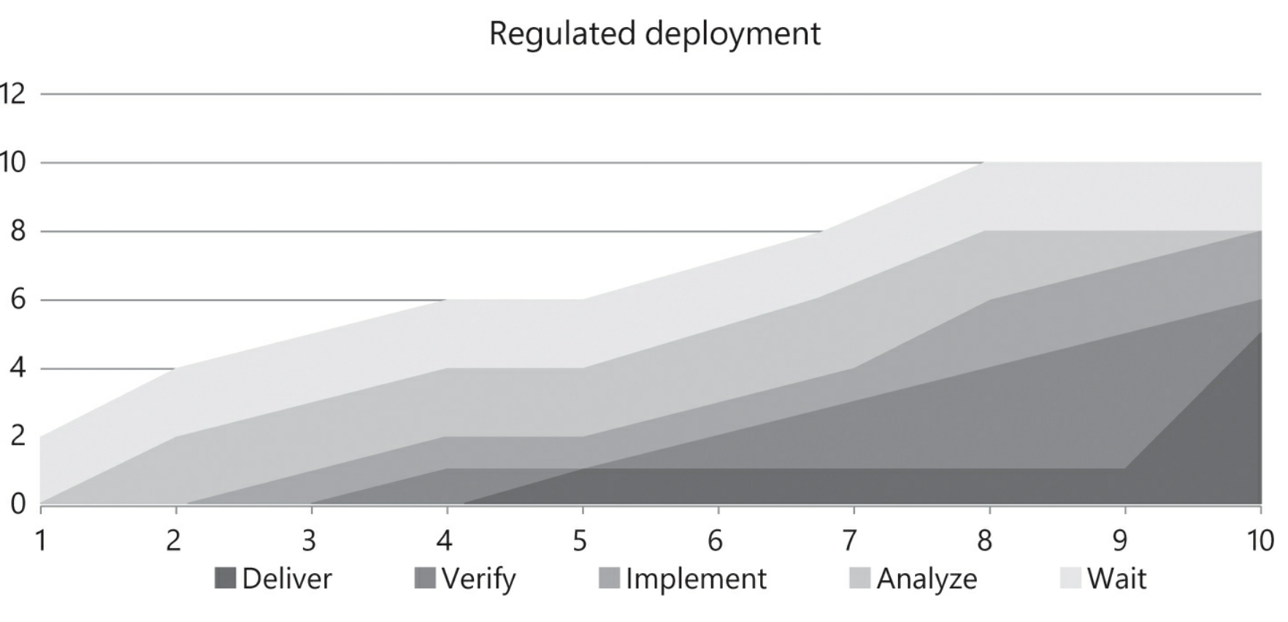
Scrum + Kanban

Slide 35

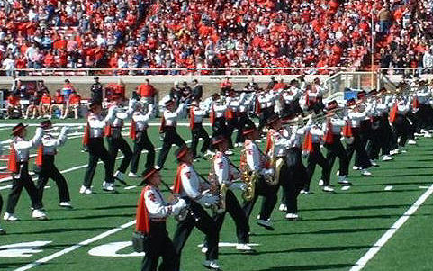
Differences
Scrum is good for structuring and regulating new and novice teams
That’s you
Marching Band or Orchestra
Kanban is what you may evolve towards as your team matures
We’ll borrow from it, but we can’t abide by it
Jazz Ensemble

